Slide 1
Use case
Best trap (prospect) to drill based on reservoir potential, trap consistency and migration-accummulation potential

Slide 2
What we know:
R2 is the reservoir rock (sandstone) (RR).
R3 is the Source rock (SR) and top seal (shale).
R1 is the lateral seal(shale).
Source Rock has generated and expulsed hydrocarbons.
Traps are fault-dependent.
Migration directly from the SR into the RR and then laterally through the RR (fill-spill migration).
Reservoir rock has good lateral continuity, porosity and permeability to allow hydrocarbons to migrate through it (scenario 1).
Reservoir properties varies based on position inside the depositional system (submarine fan).
What we do not know:
If the faults F1, F2, F3 and F4 are sealing or non-sealing.
Where inside the depositional system are these traps located.
Question to answer:
What is the best trap to drill first?
Trap4
F3
R1
F2
Trap3
F4
F1
Trap2
Trap1
SR

Slide 3
Reasoning example:
Trap 1
Sealing capacity of the fault F1 is not important for HC accumulation because there is a lateral seal (shale):-
  HC cccumulation inside the Trap 1 (fill to spill)
Sealing capacity of the fault F1 is important for lateral migration, from Trap 1 into next trap:-
  If F1 is sealing than no hydrocarbons will migrate across
  If F1 is non-selaing than hydrocarbons will migrate further (spill) into the next trap, after the Trap1 is fill to spill
Trap 2
Sealing capacity of the fault F2 is important for HC accumulation because there is no lateral seal (shale):-
  If F2 is sealing than HC cccumulation inside the Trap 2 but no lateral migration into the next trap
  If F2 is non-sealing than no accummulation inside the trap2 but Hc are migrating further into the next trap

Slide 4
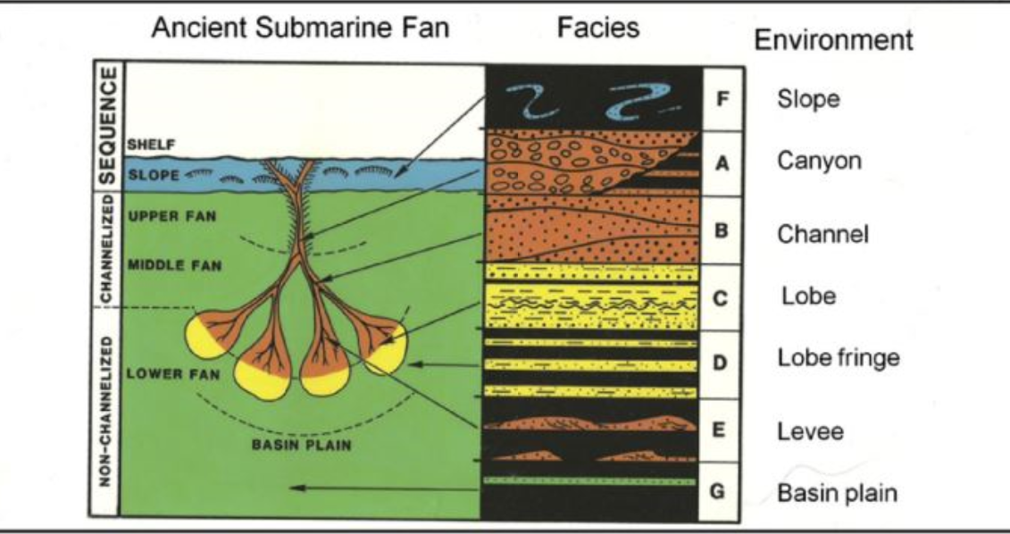
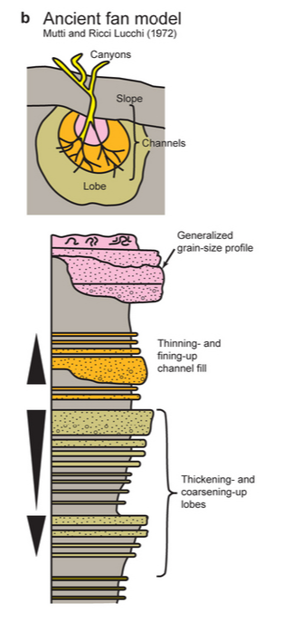
Ancient submarine fan facies distribution
(after Mutti and Ricci Lucchi, 1072)
Proximal
Distal

Slide 5
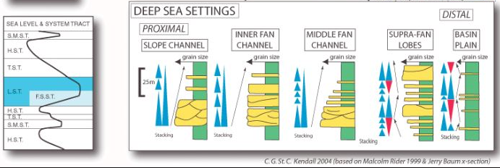
Reservoir distribution inside each component of the submarine fan

Slide 6
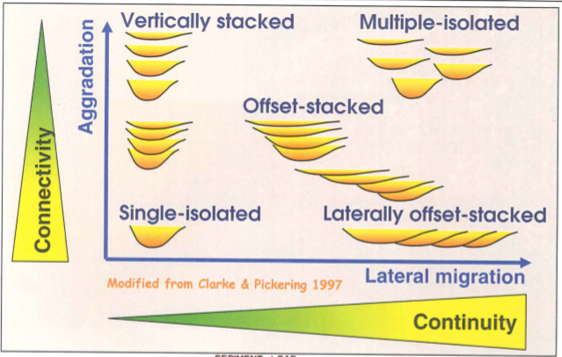
Geometry of turbidite channels

Slide 7
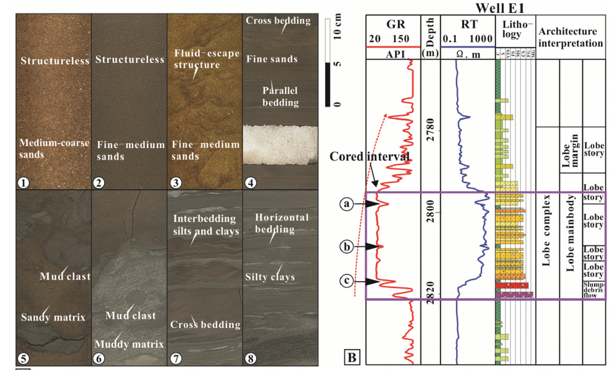
Lobe complex

Slide 8
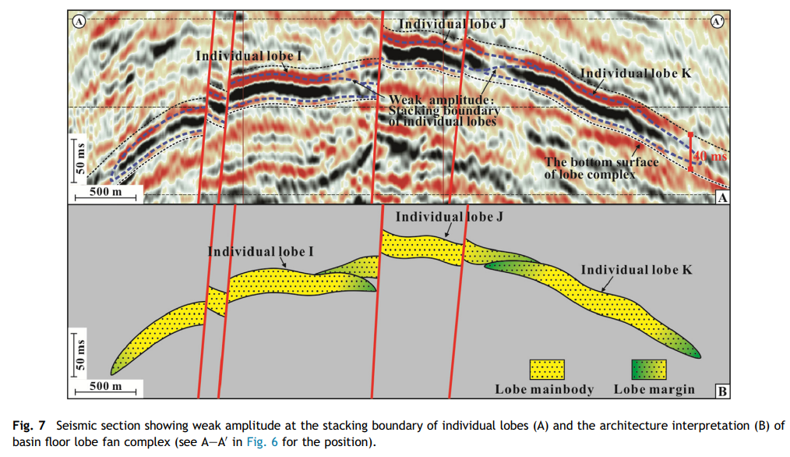
Lobes on seismic

Slide 9
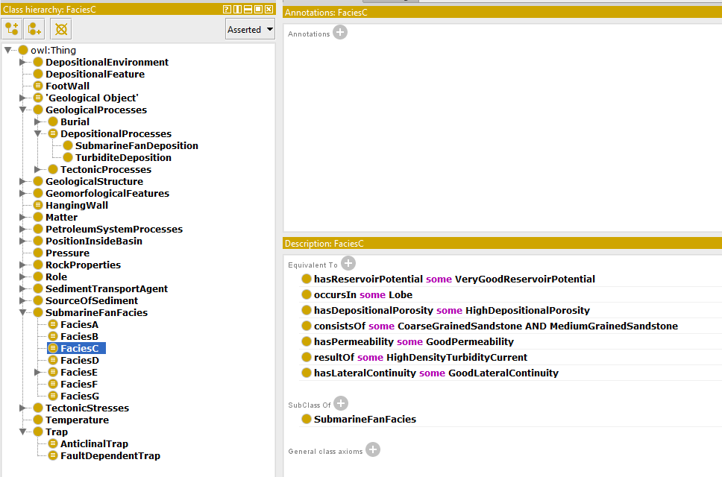
Facies characterization using ontology (example)

Slide 10
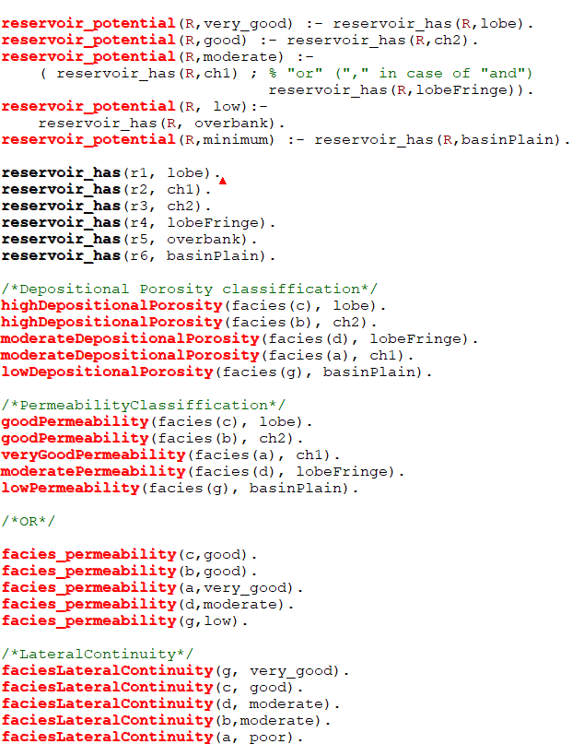
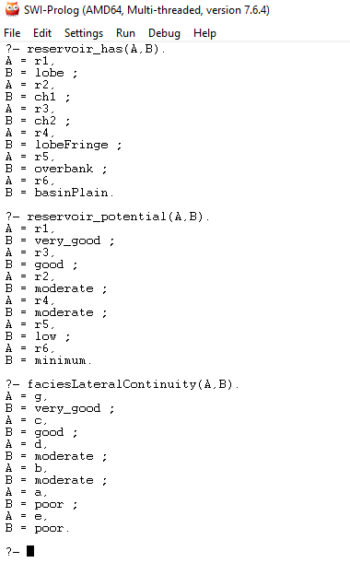
Facies characterization using FOL (example)

